Slide 1

Game Ideas
Comprehensive Development Project
Nick DeLuca

Slide 2
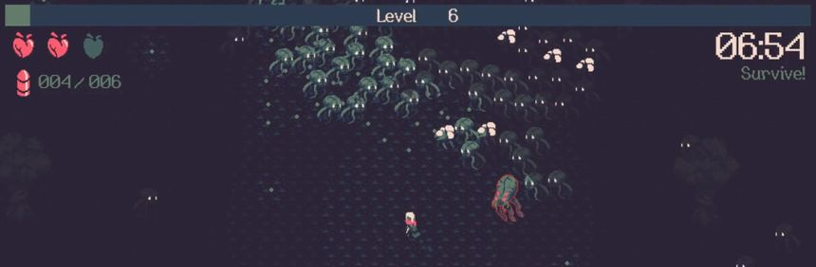
Horde Shooter Survival Game
Goal is to survive as long as possible while being swarmed by zombies
Multiple characters with different weapons
Multiple zombies with different abilities

Slide 3
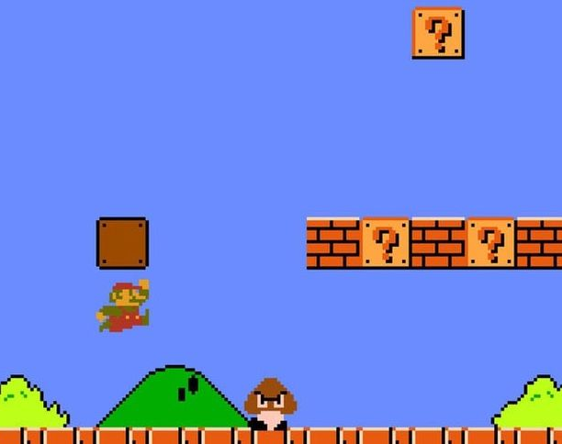
Procedurally Generated Side-Scroller Platformer
Earn points the further you go
Screen automatically scrolls, slowly speeds up as time goes on

Slide 4
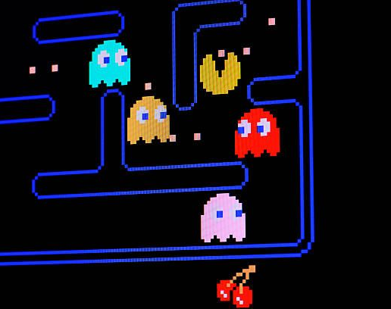
Top-Down Collectathon
Items to collect on a cube
Gates in walls on sides and top of screen lead to other areas on the cube
Enemies that hunt you down

Slide 5
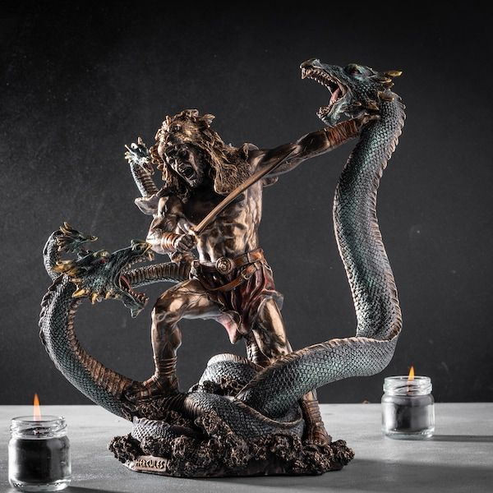
Mini-game Collection
Based on the 12 tasks of Hercules in Greek mythology
Can range from cleaning (Augean Stables) to a boss with puzzles (Lernean Hydra)

Slide 6
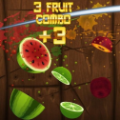
Arcade Shooter
Earn points by shooting various foods that appear on screen
Certain number of points required to proceed to a more difficult level
Level instantly lost by shooting non-food item

Slide 7
Thank You
For Listening to my pitch

